Slide 1
Build Your First Data Platform for Power BI
Kevin Feasel
feaselkl@solliance.net
Ike Ellis
ike@solliance.net

Slide 2

Ike Ellis
MVP since 2011
Author of Developing Azure Solutions, Power BI MVP Book
Speaker at PASS Summit, SQLBits, DevIntersections, TechEd, Craft, Microsoft Data & AI Conference
General Manager – Data & AI Practice Solliance
Founder of San Diego Power BI UserGroup
Founder of the San Diego Software Architecture Group
Co-chair of San Diego Data Engineering Meetup
/ikeellis
@ike_ellis
ike@solliance.net
www.ikeellis.com
youtube.com/IkeEllisOnTheMic

Slide 3

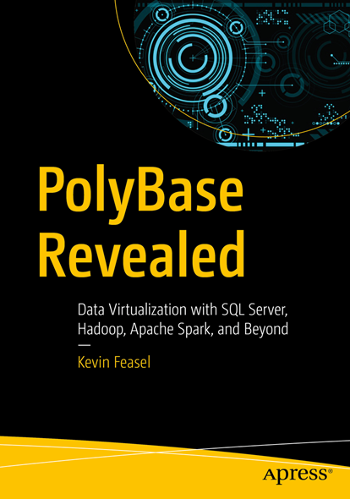
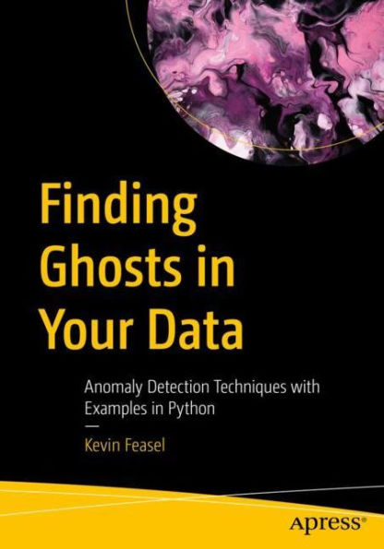
Kevin Feasel
Data Platform MVP
President, TriPASS
Data & AI Specialist
Solliance
https://curatedsql.com
@feaselkl

Slide 4
Agenda
The need for a data platform
Power BI data models are difficult to maintain
More tools can use shared resources
Platform can be professionally engineered, tested, maintained, and high-performing
Physical layers in the platform
Analytical Data Modeling
Star Schemas
Reasons to store data in files
File Types
Data Virtualization
A Brief History of Spark
Choosing a serving layer
Deciding what goes in to Power BI

Slide 5
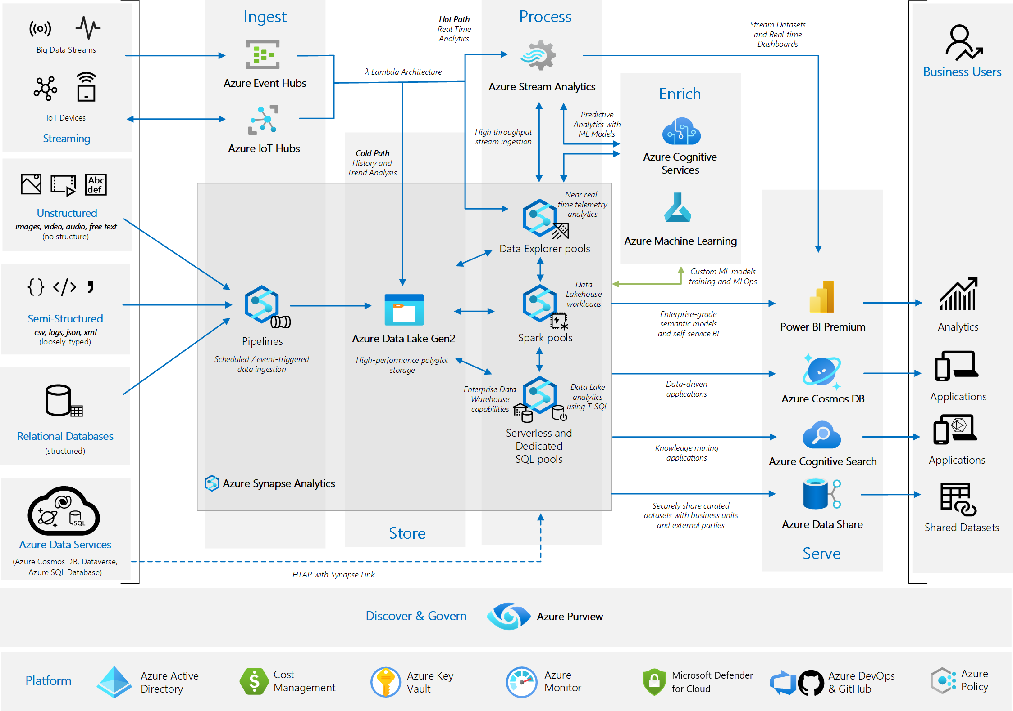
Research Azure data architecture
You’re likely to see this
Looks scary

Slide 6
At the end of this lecture, I’ll show you how to build this
Most of the components you need to get started and be successful organizing data for Power BI

Slide 7















Example Data Platform Architecture
Data Sources
Data Collection & Orchestration
Data Processing
Data Serving
Reporting
Azure Synapse Pipelines
Data pipeline activities
Notebook activities
Copy/Polybase
Synapse Analytics
Synapse Spark Pool
Metadata Definitions
Dataverse
Synapse Serverless SQL Pool
Data Storage vis Azure Data Lake Storage v2
Machine Learning & Advanced Analytics
Stage
Curated
Raw
Azure Machine Learning
Legacy ERP
Security
Monitoring & Alerting
IoT Telemetry
Azure Active Directory
Azure Key Vault
Azure Monitor
Synapse Analytics

Slide 8
Demo
Walk around a working platform

Slide 9


SQL Server as a Enterprise Data Architecture (EDA)
source
source
ods
data warehouse
staging
etl
etl
etl
etl
source
and/or
source

Slide 10
Power BI without an enterprise data platform
spread business logic
when something changes, you have to change a ton of places
inconsistent
repeatedly cleaning the same data
source
power query
source
power query
source
power query

Slide 11
Power BI without an enterprise data platform
spread business logic
when something changes, you have to change a ton of places
inconsistent
repeatedly cleaning the same data
source
power query
power query
power query
power query
power query
source
power query
power query
power query
source
power query

Slide 12
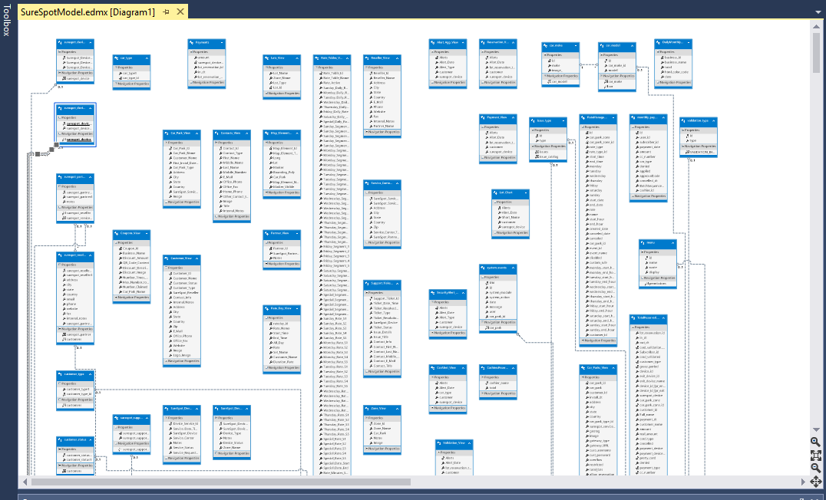
Power BI Data Models With Transactional Sources

Slide 13
Kimball dimensional modeling
Business questions focus on measures that are aggregated by business dimensions
Measures are facts about the business (nouns and strong words)
Dimensions are ways in which the measures can be aggregated:
pay attention to the “by” keyword
examples:
sales revenue by salesperson
profit by product line
order quantity by Year
Product Line
Time
Quantity
Revenue
Profit
Salesperson

Slide 14
Star schemas
Group related dimensions into dimension tables
Group related measures into fact tables
Relate fact tables to dimension tables by using foreign keys
DimSalesPerson
SalesPersonKey
SalesPersonName
StoreName
StoreCity
StoreRegion
DimCustomer
CustomerKey
CustomerName
City
Region
FactOrders
CustomerKey
SalesPersonKey
ProductKey
ShippingAgentKey
TimeKey
OrderNo
LineItemNo
Quantity
Revenue
Cost
Profit
DimDate
DateKey
Year
Quarter
Month
Day
DimProduct
ProductKey
ProductName
ProductLine
SupplierName
DimShippingAgent
ShippingAgentKey
ShippingAgentName
Notes:
Show Adventure Works Dimensions so they can see
Repeated data
Imagine Hierarchies

Slide 15
Considerations for dimension tables
Denormalization:
dimension tables are usually “wide”
wide tables are often faster when there are fewer joins
duplicated values are usually preferable to joins
Keys:
create new surrogate keys to identify each row:
simple integer keys provide the best performance
retain original business keys
DimSalesPerson
SalesPersonKey
EmployeeNo
SalesPersonName
StoreName
StoreCity
StoreRegion
surrogate key
business key
denormalized (no separate store table)

Slide 16
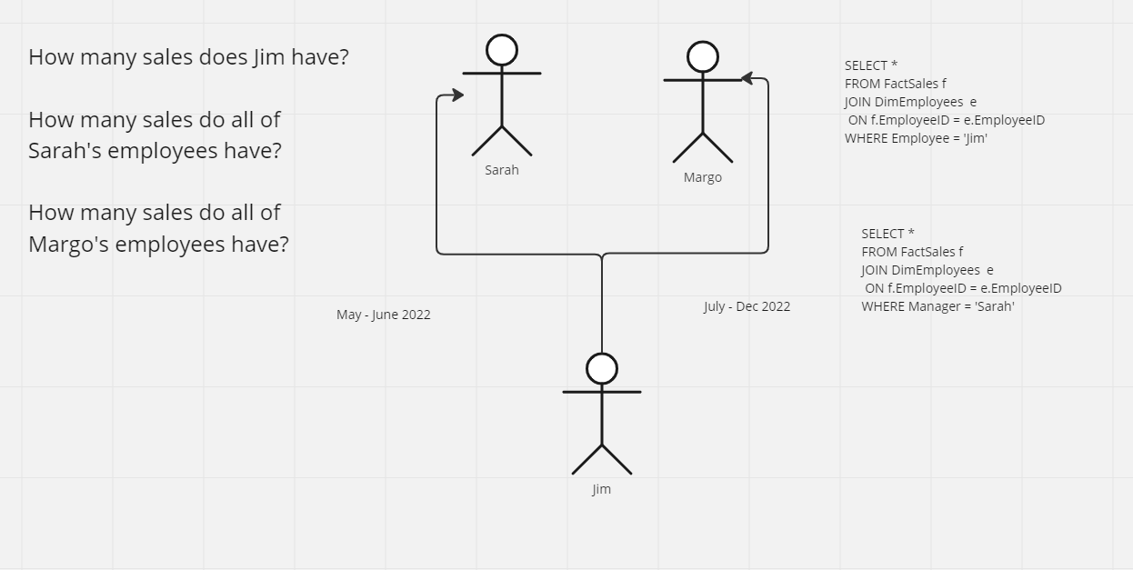
Slowly Changing Dimensions

Slide 17
Table Structure
DimEmployeeID | Employee | Manager
1 | Jim | Sarah
DimEmployeeID | Employee | Manager
1 | Jim | Margo
SELECT *
FROM FactSales f
JOIN DimEmployees e
ON f.DimEmployeeID = e.DimEmployeeID
WHERE Manager = 'Sarah'
Now the query doesn’t work. All of Sarah’s previous sales are now assigned to Margo
She doesn’t get credit

Slide 18
The key is using a surrogate key and adding two other columns
DimEmployeeID | EmployeeID | Employee | Manager | Start Date | End Date
1 | 1 | Jim | Sarah | 1/1/2022 | 6/30/2022
2 | 1 | Jim | Margo | 7/1/2022 | Present
SELECT *
FROM FactSales f
JOIN DimEmployees e
ON f.DimEmployeeID = e.DimEmployeeID
WHERE Manager = 'Sarah'
Now the query works!
SELECT *
FROM FactSales f
JOIN DimEmployees e
ON f.EmployeeID = e.EmployeeID
WHERE Employee = 'Jim'
And this query still works because we can use his name or his employeeID to get his accurate results

Slide 19
Degenerate and Conformed Dimensions
Degenerate Dimension: Dimensions in the fact table
Conformed Dimension: A dimension that has the same meaning to every fact with which it relates
Role-playing Dimension: A dimension that relates to a fact table with multiple keys, ie calendar date and fiscal year date

Slide 20
Considerations for fact tables
Grain:
use the lowest level of detail that relates to all dimensions
create multiple fact tables if multiple grains are required
Keys:
the primary key is usually a composite key that includes dimension foreign keys
Measures:
additive: Measures that can be aggregated across all dimensions
nonadditive: Measures that cannot be aggregated
semi-additive: Measures that can be aggregated across some dimensions, but not others
Grain =
Order Line Item
FactOrders
CustomerKey
SalesPersonKey
ProductKey
Timekey
OrderNo
LineItemNo
PaymentMethod
Quantity
Revenue
Cost
Profit
Margin
Degenerate Dimensions
Additive
Nonadditive
Semi-additive
FactAccountTransaction
CustomerKey
BranchKey
AccountTypeKey
AccountNo
CreditDebitAmount
AccountBalance

Slide 21
The importance of grain
Choose the minimum grain in which analytics is interesting
Controls the size of the base table
Eases analytics
Eases understanding of the data
Puts the entire organization on the same page on what is statistically interesting
Improves performance of aggregations and other calculations

Slide 22
Reasons to make a star schema
Easy to use and understand
One version of the truth
Easy to create aggregations by single passing over the data
Much smaller table count (12 – 25 tables)
Faster queries
Good place to feed cubes (either azure analysis services or power bi shared datasets)
Supported by many business intelligence tools (excel pivot tables, power bi, tableau, etc)
What i always say:
“you can either start out by making a star schema, or you can one day wish you did. those are the two choices”

Slide 23
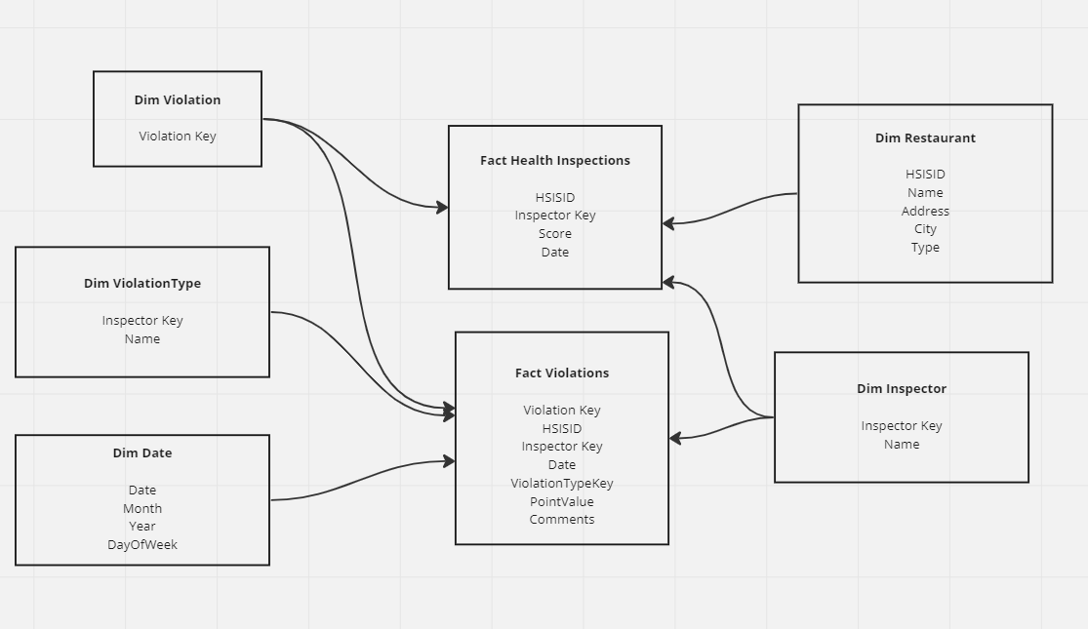
Demo: Star Schema

Slide 24
Don’t be afraid of files
files are fast!
files are flexible
new files can have a new data structure without changing the old data structure
files only write the data through one data structure
files can be indexed
file storage is cheap
files can have high data integrity
files can be unstructured or non-relational
Easily copied
The whole idea of an analytical system is that data duplication will speed up aggregations and reporting. Files allow for cheap duplication, which allows us to duplicate more data more frequently.

Slide 25
Parquet files
Organizing by column allows for better compression,
The space savings are very noticeable at the scale of a Hadoop cluster.
I/O will be reduced as we can efficiently scan only a subset of the columns while reading the data.
Better compression also reduces the bandwidth required to read the input.
Splittable
Horizontally scalable

Slide 26

Basic physical idea of a data lake
data mart
staging
ods
data mart
source
etl
etl
etl
etl
data mart
etl
etl
etl

Slide 27
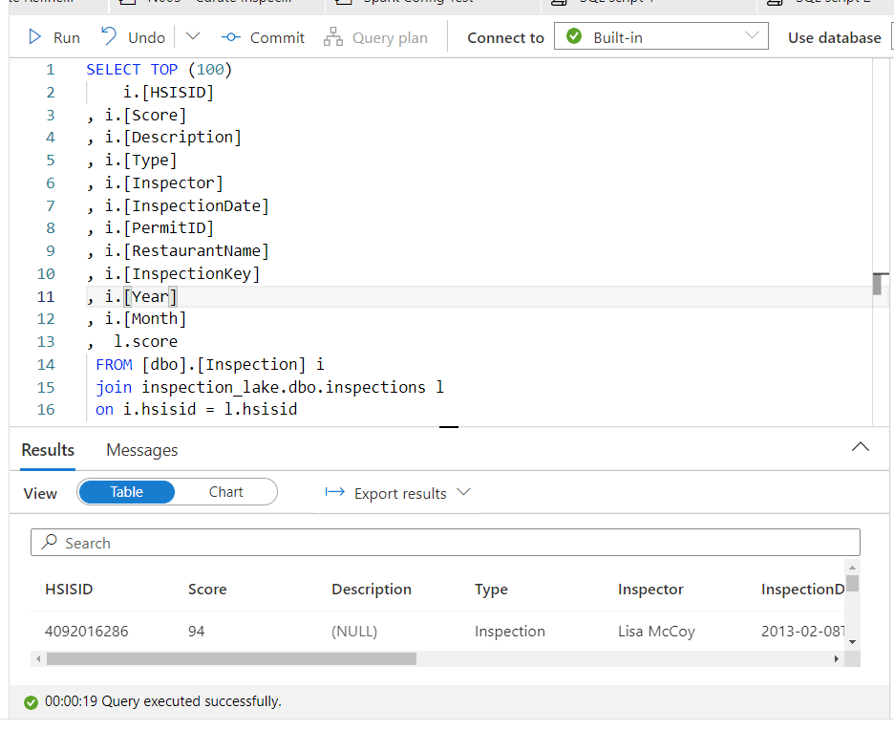
Imagine using T-SQL to query all of your data, regardless of where it is stored
T-SQL in all the places

Slide 28
Data virtualization as a concept
data stays in it’s original place
sql server
azure blob storage
azure data lake storage gen 2
metadata repository is over the data where it is
data can then be queried and joined in a single location
spark sql
polybase
hive
power bi
sql server big data clusters

Slide 29
Demo: Data virtualization, T-SQL, Parquet Files

Slide 30
DEMO: A Brief History of Spark
Hadoop
HDFS
Spark

Slide 31
Deciding the correct location for data marts
Spark Tables | Dedicated SQL Pools | Azure SQL DB Hyperscale | Azure SQL DB MI | Regular Azure SQL DB
Great for Power BI refreshes for direct import Good performance for querying Really cheap | Most expensive option Great for very large data, partitioned data that needs to be very fast Pausable compute to save expenses | Great for large databases that have a lot of data to load and have log contention Cheaper than Dedicated SQL Pools Same interface as Azure SQL DB | Good if you still need SSIS, SQL Server Agent, Cross-database queries, Linked Servers, etc. | Good for small, medium data marts Can be cheap or expensive Cost can be more elastic

Slide 32
The difference between orchestration and transformation
Orchestration decides which work gets done first
This is better done in Azure Synapse Pipelines
Transformation is the actual work
This is better done in Azure Spark Notebooks

Slide 33
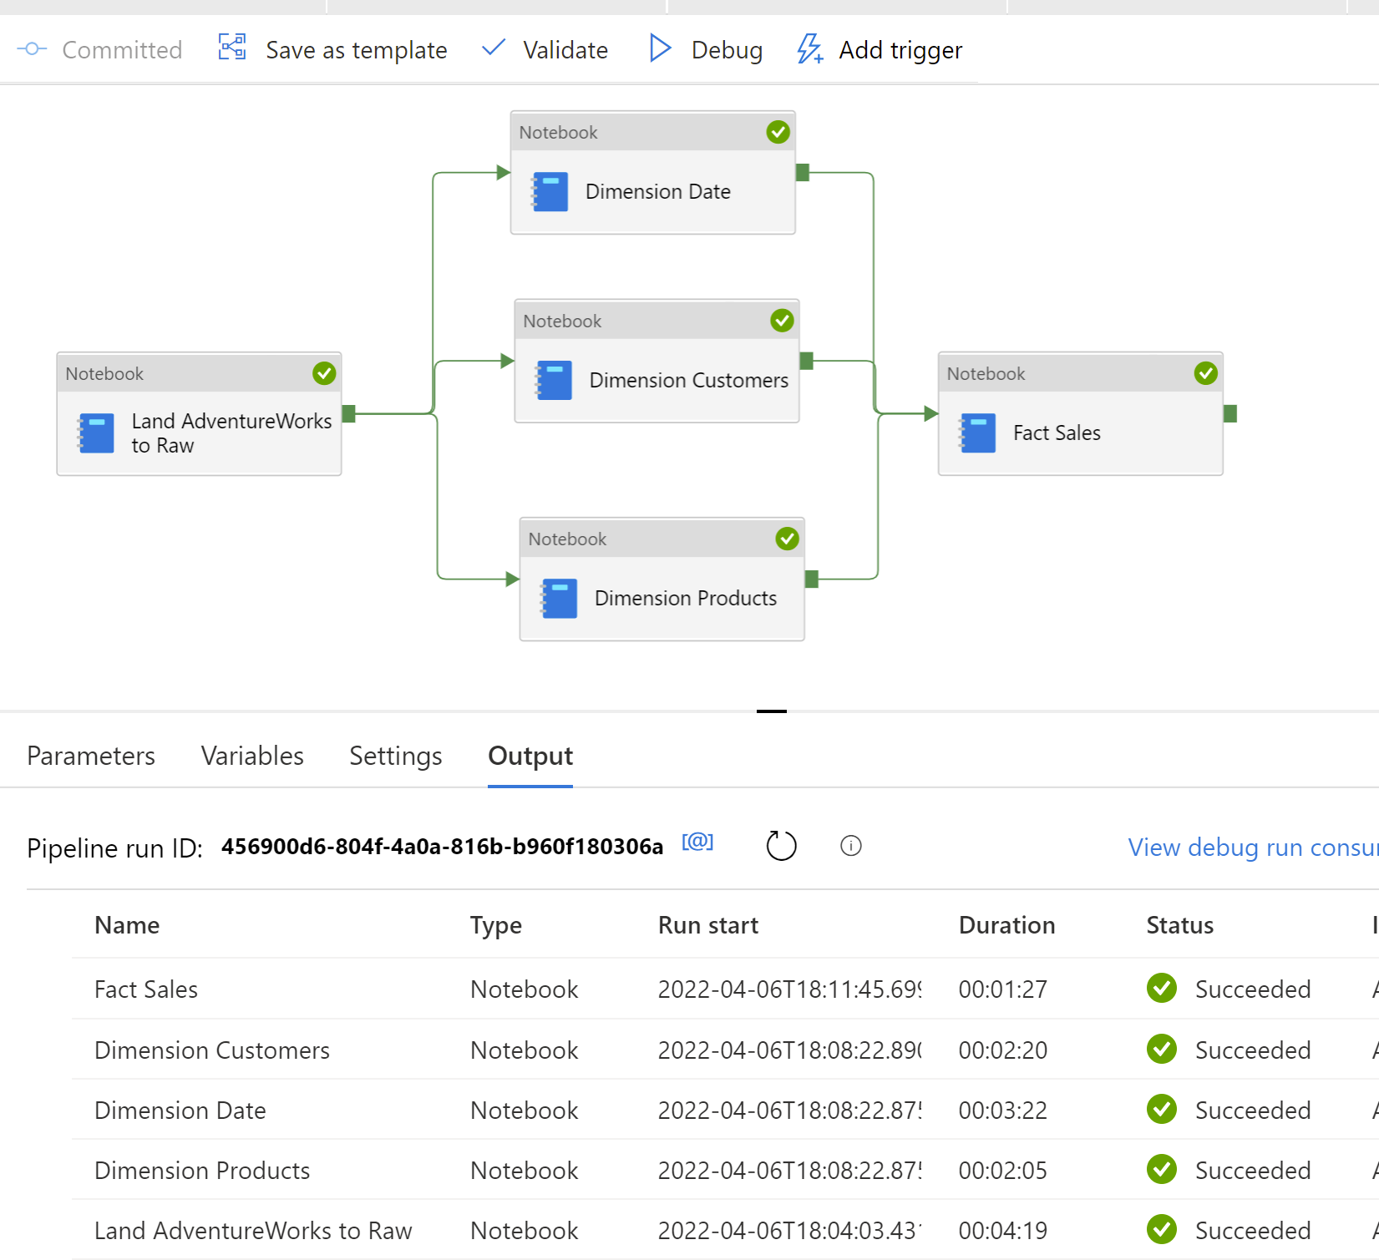
Creating an orchestration pipeline
Use pipelines (or ADF) for orchestration, not for real work
Do the real work in notebooks
Much easier to troubleshoot and debug and support
Keeps the pipelines as simple as possible

Slide 34
Demo: Show code notebooks and orchestration

Slide 35
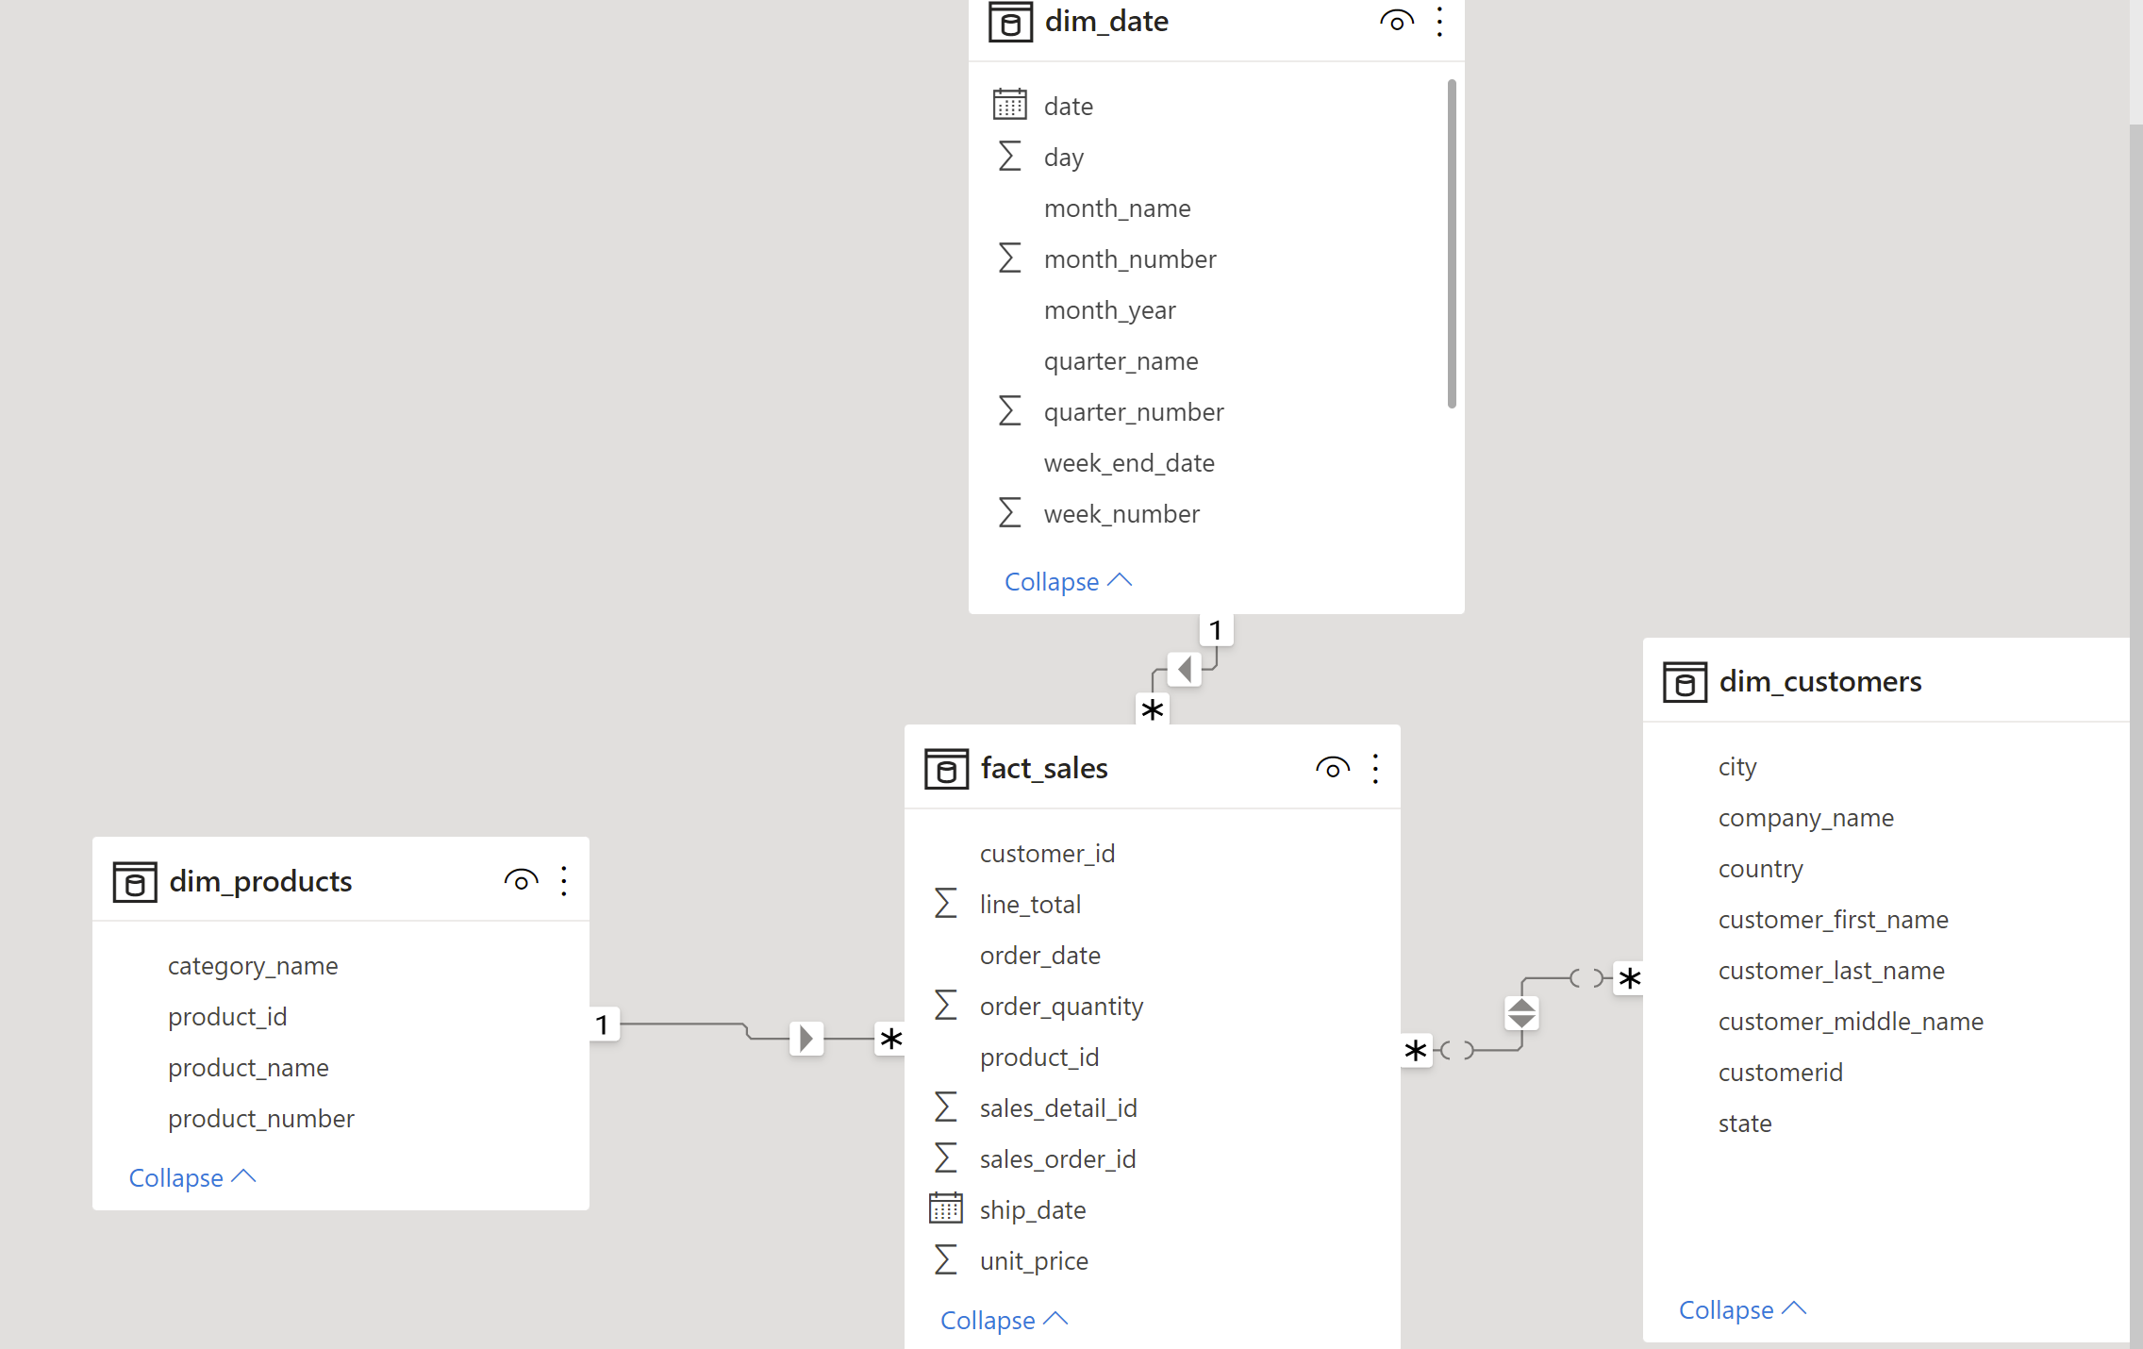
What logic stays in the data platform and what goes to Power BI
Can load spark just from the SQL Server connection
Power BI data models should be simple
Fight for simplicity
Most cleaning and data prep should be in Synapse Pipelines

Slide 36
conclusion
yes, we still make star schemas
yes, we still use slowly-changing dimensions
yes, we still use cubes
we need to understand their limitations
don’t be afraid of files and just in time analytics
don’t conflate alerting and speed with consistency
consistent reporting should be kept to 50 reports or less
everything else should be de-coupled and flexible so they can change quickly
we can create analytic systems without SQL Server (but with SQL)
file-based (parquet)
we still primarily use SQL as a language
cheap
massively parallel
easily change-able
distilled using a star schema and data virtualization

